Slide 1
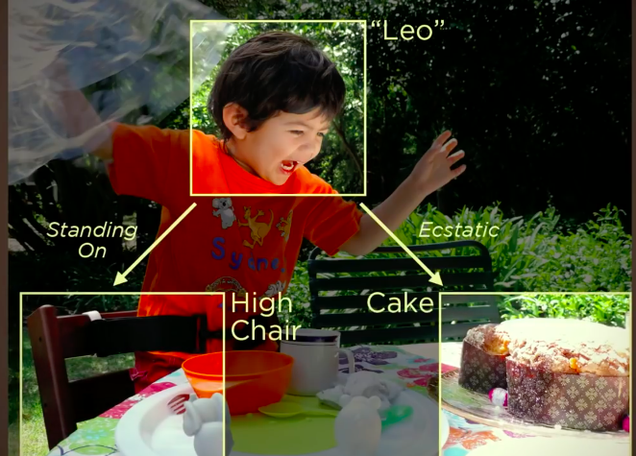
NPTEL
Video Course on Machine Learning
Professor Carl Gustaf Jansson, KTH
Week 6 Machine Learning based
on Artificial Neural Networks
Video 6.8 Convolutional Networks – Part 2

Slide 2

A typical Convolutional Neural Network Architecture

Slide 3
Convolutional Neural Network related Terminology
Convolution
Filter (or synonymously Kernel)
Stride
Padding
Feature map
Parameter sharing
Local connectivity
Pooling Subsampling Downsampling
Subsampling ratio
Maxpooling Average pooling
ReLU
Softmax

Slide 4
The Feature Learning Phase
The feature learning phase in a CNN consists of an arbitrary number of pairs of Convolution and Pooling layers.
The number and roles of these pairs of layers are engineering decisions for particular problem settings but in general later (deeper) levels handles more abstract or high level features or patterns in analogy with our assumed model of the functioning of the human visual cortex.

Slide 5
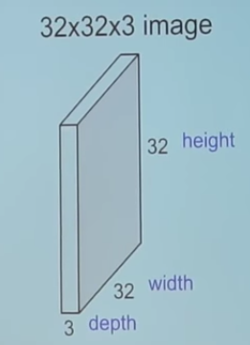
Example
An input image of RGB type.

Slide 6
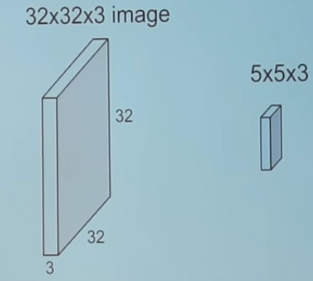
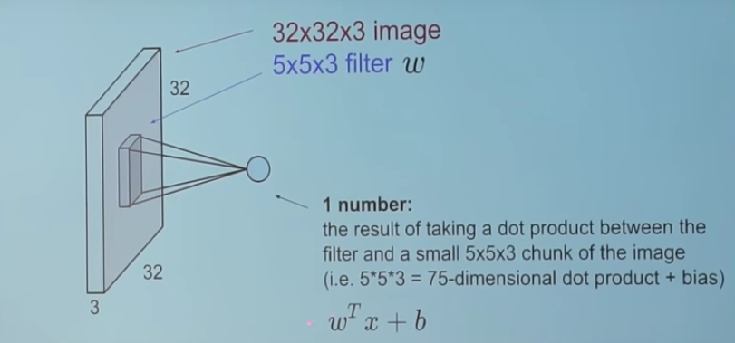
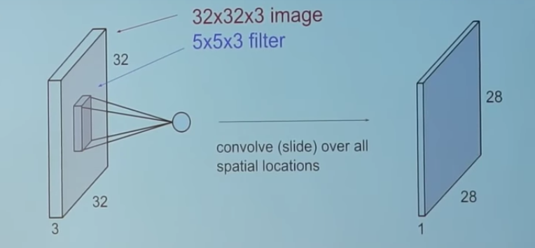
Convolution for one Filter in a Convolution Layer
In our example we take a 5*5*3 Filter and Slide it over the Input array with a Stride of 1.
Let us disregard the color dimensions for a moment.
In each step of the slide, take the dot product between each filter element and each element of each subarea of the Input array. For every dot product taken, the result is a scalar.
There are 28*28 unique positions where the filter can be put on the image and the therefore the total result is a Feature Map = a 28x28x1 array.
If the Stride is larger than 1 the Feature Map becomes more reduced.

Slide 7
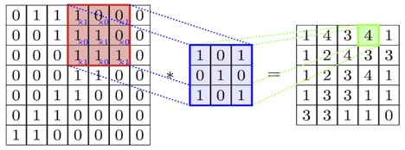
Example of a filter and a single convolution operation
The input is a 7x7 array with 49 elements The filter is shown in the middle. The filter size is 3x3 (black and white), the stride is 1. This is an example of a filter that detects diagonal patterns (1 on the diagonals). The output is a 5x5 array with 25 elements.
We slide the array systematically across the input array (analogy with convulotion). There are 25 distinct distinct sliding positions. For each position we calculated the dot product elementwise and puts the result in the output matrix.

Slide 8
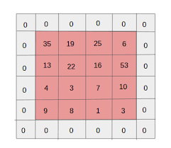
Padding
Depending of the size of input array, size of filters and stride, the sliding process can miss to apply the filter to some input array element.
A possibilty is to ´pad´ the original input array with a frame and use he extended array as a basis for the convolution.
Wether this is benefical for the process or not depends on
the specific situation.
If padding is never used, the system of arrays are shrinking
rapidly but if padding is used sytematically the size of arrays are kept up.

Slide 9
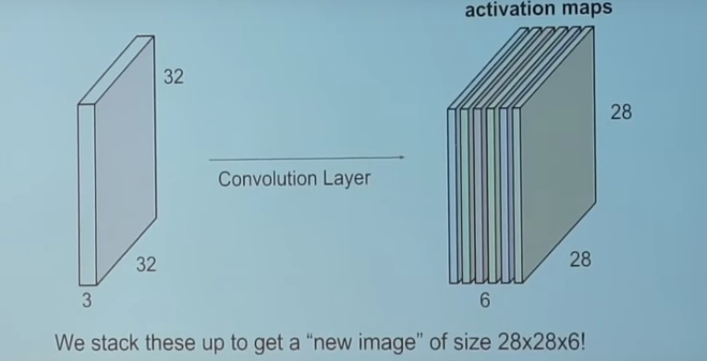
Repeated convolution for all
filters in a convolution layer
Each convolution layer comprises a set of independent Filters.
Each filter is independently convolved with the input image.
In the example there are 6 filters in this first convolution layer.
Which generates 6 feature maps of shape 28*28*1.

Slide 10
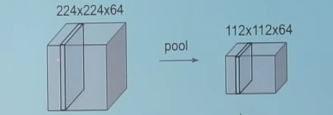
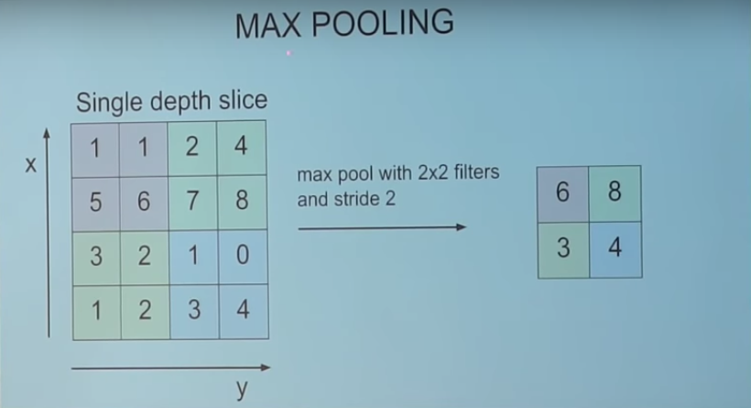
Pooling (Subsampling) Layer
A Pooling layer is frequently used in a convolution neural network with the purpose to progressively reduce the spatial size of the representation to reduce the amount of features and the computational complexity of the network.
Pooling layer operates on each Feature map independently.
The main reason for the pooling layer is to prevent the model from overfitting.
The choice of filtersize, stride (and maybe padding) are also
relevant for the pooling phases.
The most common approach used in pooling is Max pooling.
As an example a MAXPOOL of 2 x 2 would cause a Filter of 2 by 2 to traverse over the entire matrix with a Stride of 2 and pick the largest element from the window to be included in the next representation map. Average pooling takes the average.

Slide 11
Two aspects of the neuron structures
in the convolution and pooling layers
Weight-sharing
Based on the motivation that a certain feature/filter should treat all subareas of the visual space similarity the same weights should be employed within a convolution computation phase. This
brings down the complexity of the networks
Local connectivity
In contrast to general ANN, the neuron connections in the input, convolution and pooling layers are restricted, primarily motivated by the fact that specific neurons are allocated to only small sub-areas of the total visual field. This brings down the complexity of the networks.

Slide 12
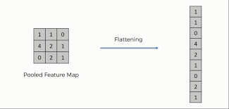
Flattening
When leaving the convolution and pooling layers and before entering the fully connected layers the output of the previous layers is flattened.
By this is meant that the dimensions of the input array from earlier phases are flattened out into one large dimension.
For example a 3 D array with a shape off (10x10x10) when flattened would become a 1 D array with 1000 elements.

Slide 13
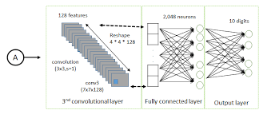
The Fully Connected Layers
The fully connected layers takes as input, a flattened array representing the activation maps of high level features from earlier layers and outputs an N dimensional vector.
N is the number of classes that the program has to choose from. For example, if the task is digit classification, N would be 10 since there are 10 digits.
The fully connected layers determine which features best correlate to a particular class.
If a Softmax activity function is used, each number in this N dimensional vector represents the probability of a certain class.
For example, if the resulting vector for a digit classification program is [0, 0.1, 0.1, 0 .75, 0, 0, 0, 0, 0, 0.05], then this represents a 10% probability that the image is a 1, a 10% probability that the image is a 2, a 75% probability that the image is a 3, and a 5% probability that the image is a 9.

Slide 14
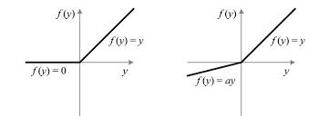
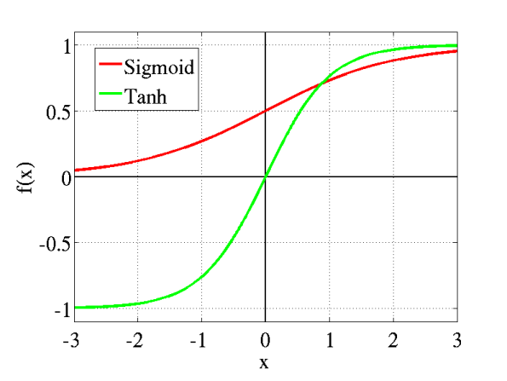
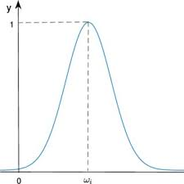
Activation functions used
ReLU (Rectified Linear Unit) and Leaking ReLU activation functions
The advantages are simplicity and efficiency.
Typically used in the convolution layers of CNN.
Sigmoid and hyberbolic tangent (Tanh) functions
Sigmoid and Tanh are typically used for fully connected networks aimed for binary classification problems. Can be used for the output layers of a CNN
Softmax
Softmax is equivalent to Sigmoid for binary classification but is primarily aimed for the multi class case where the non-normalized output of a network is mapped onto a probability distribution over predicted output classes.
Typically used in the output layers of CNN.
Gaussian activation function
Can be used for the output layers of a CNN.
For regression problems, the final layer has typically an identity activation.

Slide 15
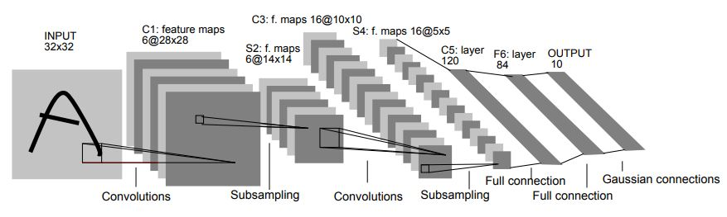
LeNet-5 – A Classic CNN Architecture
In 1990 Yann LeCun, Leon Bottou, Yosuha Bengio and Patrick Haffner proposed a neural network architecture for handwritten and machine-printed character recognition which they called LeNet-5. The architecture is straightforward and simple to understand and well suited as an Introduction to CNNs.
The LeNet-5 architecture consists of:
two sets of convolutional and average pooling (subsampling) layers followed by
one flattening convolutional layer, then
two fully-connected layers and finally
one Softmax classifier.

Slide 16
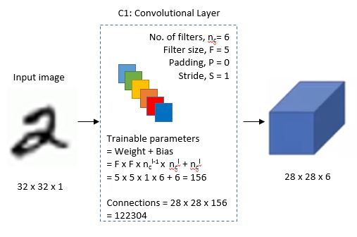
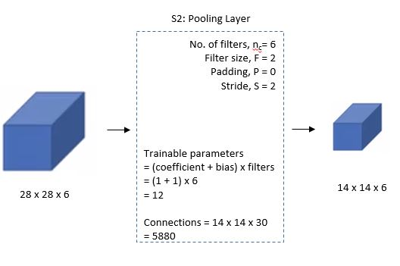
First Layer
The input for LeNet-5 is a 32×32 grayscale image which passes through the first convolutional layer with 6 feature maps or filters having size 5×5 and a stride of one. The image dimensions changes from 32x32x1 to 28x28x6.
Second Layer
Then the LeNet-5 applies average pooling layer or sub-sampling layer with a filter size 2×2 and a stride of two. The resulting image dimensions will be reduced to 14x14x6.

Slide 17
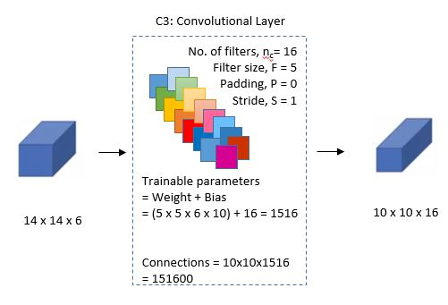
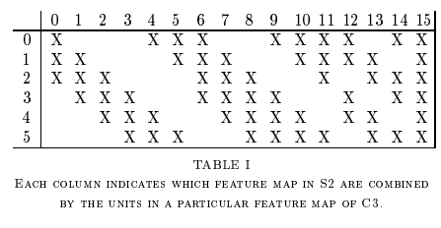
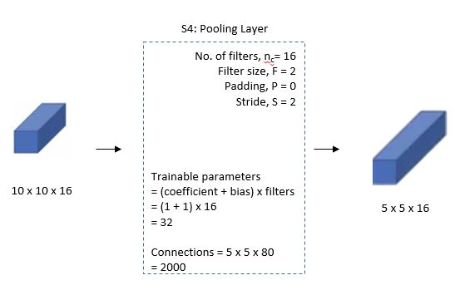
Third Layer
Next, there is a second convolutional layer with 16 feature maps having size 5×5 and a stride of 1. In this layer, only 10 out of 16 feature maps are connected to 6 feature maps of the previous layer as shown below. The main reason is to break the symmetry in the network and keeps the number of connections within reasonable bounds. That’s why the number of training parameters in this layers are 1516 instead of 2400 and similarly, the number of connections are 151600 instead of 240000
Fourth Layer
The fourth layer (S4) is again an average pooling layer with filter size 2×2 and a stride of 2. This layer is the same as the second layer (S2) except it has 16 feature maps so the output will be reduced to 5x5x16.

Slide 18
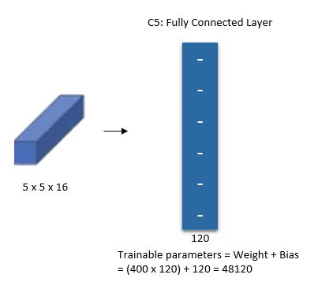
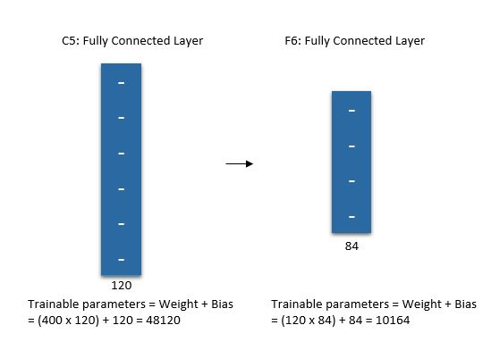
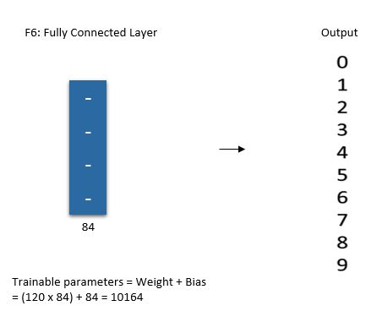
Le-Net-5 layers
Fifth Layer
The fifth layer (C5) is a fully connected convolutional layer with 120 feature maps each of size 1×1. Each of the 120 units in C5 is connected to all the 400 nodes (5x5x16) in the fourth layer S4.
Sixth Layer
The sixth layer is a fully connected layer (F6) with 84 units.
Output Layer
Finally, there is a fully connected Softmax output layer ŷ with 10 possible values corresponding to the digits from 0 to 9.

Slide 19
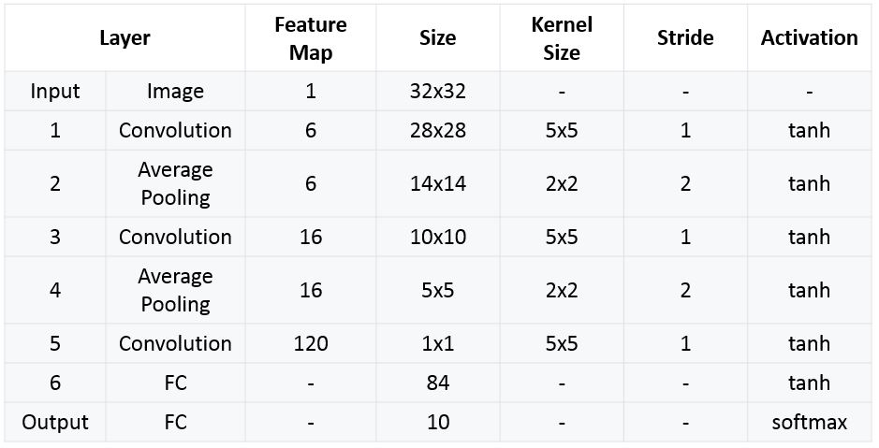
Summary of Le-Net-5 architecture

Slide 20
Timeline for CNN
1980 The Neocognitron, introduced by Kunihiko Fukushima.
1987 Time delay neural networks (TDNN), introduced by Alex Waibel.
1989 A system to recognize hand-written ZIP Code numbers using convolutions based on
laboriously hand designed filters, introduced by Yann LeCun.
LeNet-5, a pioneering 7-level convolutional network by Yann LeCun.
The first GPU-implementation of a CNN was described in by K. Chellapilla.
Alexnet, A GPU-based CNN by Alex Krizhevsky
won the ImageNet Large Scale Visual Recognition Challenge.

Slide 21
NPTEL
Video Course on Machine Learning
Professor Carl Gustaf Jansson, KTH
Thanks for your attention!
The next lecture 6.9 will be on the topic:
Deep Learning and recent developments

